Slide 1

Exercises

Slide 2
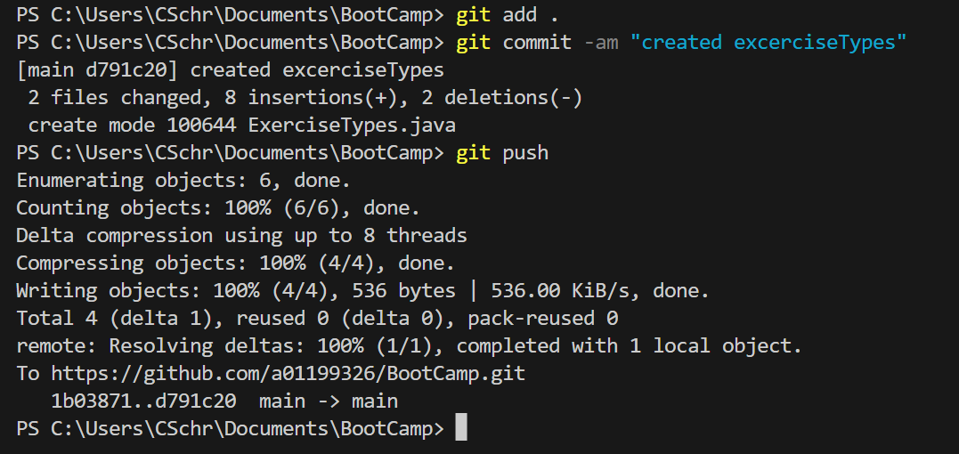
Types of data
Make in a java file an instance of all the types we saw and then make 4 more instances of types you want, but that are not the ones we talked about.
double x = 0.0;
int y = 1;
boolean bool = true;
String hello = "hello";
Type name = value;

Slide 3
Classes, Methods and inheritance
Create a class, shape, that has the method calculate area and a method to set its position (x, y). Then choose to shape of your choice and make subclases that inherit from the shape class and override the calculate perimeter function without changing the set position function.

Slide 4
Classes and subclasses
Create a class animal that has the function eat and make sure you can give the amount of food the animal ingests and calculates a hunger number, and attributes: height, weight and breed. Then choose 4 animals of your choice and make classes that inherit from the animal class, and make sure to be able to set the height weight from the constructor and the breed is auto filling since your already know the animal. then instantiate them.

Slide 5
Simple Electric, 01
Go into tinkercad.com and create a simple circuit where by pressing a button a motor turns on, use whichever motor you want and whichever button you want.

Slide 6
Simple Electric, 02
Go into tinkercad.com and create three circuits a series circuit a parallel circuit and one that you want. They have to have 3 leds, two motors and one pot that controls the speed of another motor, total three motors.

Slide 7
Robots
Write how would you abstract the 2022 offseason robot.

Slide 8
Mechanisms
Make a simple motor mechanism that allows you to write to the motor. No fancy stuff, just API like.

